Slide 1

API 102:
Building Workflows with APIs
Consuming APIs like a pro

Slide 2

Mission
You've been hired by a professional music blogger to create a workflow that helps them discover new music.
You'll use the Spotify Web API to let the blogger search for songs they like and find similar music!

Slide 3

What you will learn
Making API requests with Auth
Calling a real-world REST API
Chaining multiple API calls to build a workflow
Visualizing response data
go.postman.co/build

Slide 4

Agenda
1 | Intro to Auth in APIs
2 | OAuth Explained
3 | Intro to Postman Workflows
4 | Try it out: Building Workflows in Postman
5 | Q&A
go.postman.co/build
Notes:
Reminder that we’re using the web, not the desktop app
Today we’re learn how to build an automated API workflow in Postman to create a Song Discovery App with the Spotify API. First we’ll go over authentication and OAuth, then we’ll talk about building workflows themselves, and finally we’ll get to building. Once we’re done I’ll share some follow-up resources to further your learning. At the end we’ll have time for Q&A but if you have any questions at all please feel free to put them in the chat. Let’s get started!

Slide 5
What is Auth?
And why do APIs use it?

Slide 6

Introducing: Auth
Authentication and Authorization
Authentication = verifying identity
Authorization = granting permissions
Authentication and authorization are the first line of defense for the API, protecting the server from malicious requests and securely sharing sensitive data.

Slide 7
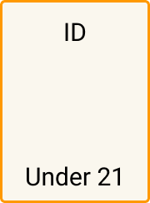
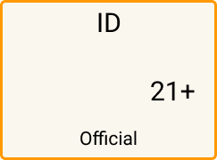

Authentication vs Authorization
Authentication identifies that you are who you say you are.
Authorization verifies what permissions you have.
Notes:
Authentication - having your passport checked at airport to verify you are who you say you are Authorization - Being allowed to order a beer at a bar because your credentials show you are old enough to drink

Slide 8


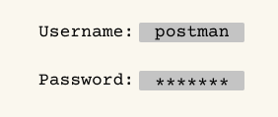
Types of Auth in APIs
A brief history
Basic auth
Simple HTTPS auth method using username and password credentials to verify users
API Key
Basic authentication using an alphanumeric string for verification.
OAuth
Sophisticated auth method using a series of tokens and IDs to authorize requests
Notes:
Basic Auth going out of fashion because it requires sharing sensitive credentials that are not easily revoked in case of abuse

Slide 9
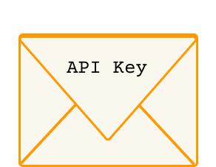
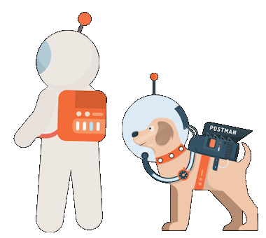
API Keys
Your invitation to use the API
a4db08b7-5729-4ba9-8c08-f2df493465a1
API keys are alphanumeric strings that provide basic access to the API’s services and data.
These allow developers to impose rate limits and revoke access in a ToS violation.
Notes:
An API Key is a method of authorization that functions like an invitation from the API. You register an account with the API service and it gives you an API Key to include in your requests. This way the API can keep track of how many calls you make and how often, allowing APIs to charge money based on the usage, and protect themselves by revoking the invitation if the caller abuses the terms.

Slide 10
OAuth: Where the Magic Happens

Slide 11
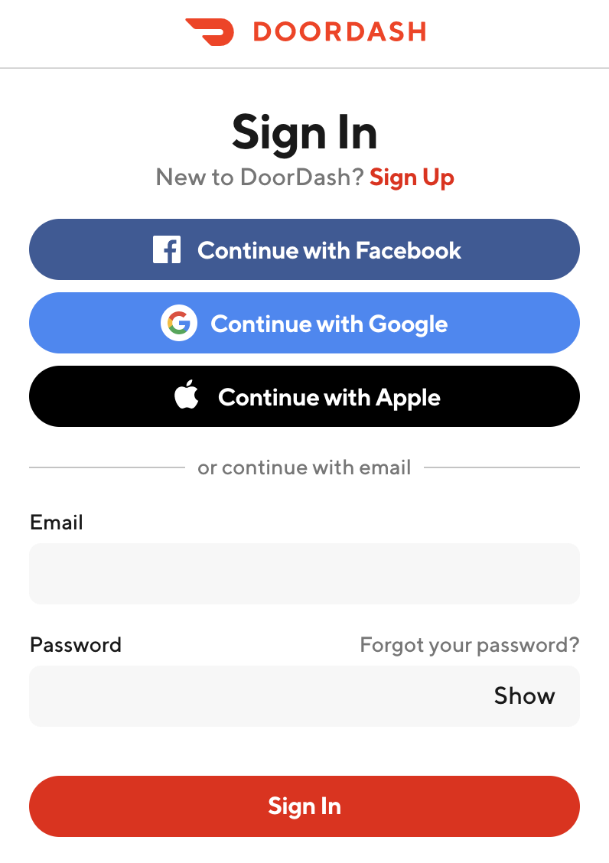
OAuth
Making the magic happen
OAuth (Open Authorization) is an authorization framework.
It requests authorization from a user to give access to personal data without asking for the user’s password.
Instead, this task is delegated to access tokens. These tokens allow apps to access certain parts of a users data under specific scopes.
Notes:
You’ve probably seen this page before or something similar when logging into a website recently. Instead of creating an account, you log into a service using an existing account, maybe Google or Facebook. OAuth is what makes this possible. For example, a service like doordash could ask a user for their permission to share certain data from Google like their name, email address and location data without asking the user for their Google password. Google will only share the data the user has given the application permission to view - these data permissions are called “scopes”
Layers like Open ID Connect can be added on top of OAuth to add Authentication service to an auth flow.

Slide 12



OAuth: A valet key
Notes:
OAuth works like a valet key for a luxury car. A valet key is a special car key that valets can use to move a car owner’s car to and from a parking space - but imagine this key comes with limitations. It can be used to start the car and move it a short distance, but cannot open the glovebox or trunk, or allow the valet to drive off into the sunset. OAuth tokens work in a similar way. The resource owner (user) grants a client (application) limited access to some resources they own elsewhere, without giving them their “master key”, or actual credentials.

Slide 13
History lesson - OAuth 1 and 2
Quick facts
OAuth has two versions: OAuth 1a and OAuth 2.0
OAuth 1 grew rapidly, but used digital signatures that are complicated to implement.
OAuth 2 simplified the process by using HTTPS protocol instead of signatures. Not backwards compatible with OAuth 1
Nowadays when people refer to “OAuth” they usually mean OAuth 2.
OAuth 1: uses HMAC-SHA signatures to authorize - super secure
OAuth 2: uses tokens over HTTPS - better developer experience
Notes:
The beginnings of OAuth1 started in 2006 when Twitter was developing its own OpenID system. Eventually other interested parties got involved and together developed and released a standard (OAuth1) in 2007. It became popular as a standardized solution for the issue sharing of data without having to reveal passwords from one service to another.
OAuth 2.0 simplified the developer experience by allowing the authorization to happen over HTTPS instead of complicated digital signatures. Since this fundamentally changed the way OAuth performs, OAuth 2 is not backwards compatible with OAuth 1

Slide 14


Do the OAuth Dance 🕺🏽
Authorization code grant type
1. Authorization Request
Resource owner
(User)
Client
(Application)
“Can I view your Google contacts?”
2. Authorization Grant Code
“OK!”
3. Authorization Grant Code
Authorization
server
“Please give me an access token”
4. Access Token
“Here you go”
5. Access Token
Resource
server
“Please give me the user’s contacts”
4. Protected Resource
“Here you go”
Notes:
The goal of OAuth is to obtain an access token. There are several different “dances” that can be done to obtain the access token, depending on application type. Here is the typical OAuth 2.0 flow for the common “Authorization code” grant type. This grant type requires the application to make at least 3 requests in order to authorize requests. Let’s say for example there is an address book application that needs access to a user’s Google contacts.
The application (Client) requests authorization from the user (Resource Owner) to access a scope of their resources - for example their Google contacts. Oftentimes this step is done using a third party authorization server as an intermediary, having the user log in to the third party in a popup to grant permission. An Authorization Code is sent back to the application.
After getting permission from the user (resource owner), the application makes a request to the Authorization Server to validate and trade the Authorization Code for an Access Token. Sometimes the authorization server also returns a “refresh token”, so that the app can continue making requests without re-asking the user for permission during a session.
By including the access token in request headers, the application can access protected resources (like Google contacts) from the Resource Server
Glossary: Client (Application): A third party application requesting access to the user’s resources from another party.
Resource Owner (User): Entity allowing access to their protected resources, such as account information Authorization Server: The server that trades a user’s authorization grant code for an access token. This token allows access to a resource server. Resource Server: The server that controls access to the user’s protected resources.

Slide 15
Do the OAuth Dance 🕺🏽
Grant types
Grant Type | Optimization | When to Use
Authorization Code | Server + Web/Mobile | For apps involving a backend (server) that can hide a client secret
Authorization Code with PKCE | Web, Mobile | Single-Page apps and native apps, where client secret cannot be hidden from public
Password | 1st Party Apps | For security reasons, this should only be used with apps made by the service itself (1st party apps)
Client Credentials | Server-to- server | For application-to-application communications when a user is not present in the workflow and the client must authenticate itself
Implicit | Legacy | Now prefer use of Authorization Code with PKCE for frontend-only apps.
Notes:
OAuth 2.0 always begins by getting authorization from the user. There are a few different ways that this authorization is granted. These different methods of granting authorization are called grant types
These grant types are optimized for different types of applications, such as web apps, mobile apps, server-to-server applications or first party applications
Authorization Code: User is prompted to allow or deny access to a third party resource. If allowed, an auth code is provided to further the OAuth process
Auth Code with PKCE: PKCE (pixie) is a code challenge extension to protect sensitive data on application without a client secret. This is useful for applications without a server backend to hide the client secret
Password: Username and password are exchanged for an access token. (only for first party apps)
Client Credentials: No user is present, the client uses a set of credentials to authorize itself.
Implicit: Former preference for frontend-only apps. Now prefer Authorization with PKCE which is more secure

Slide 16
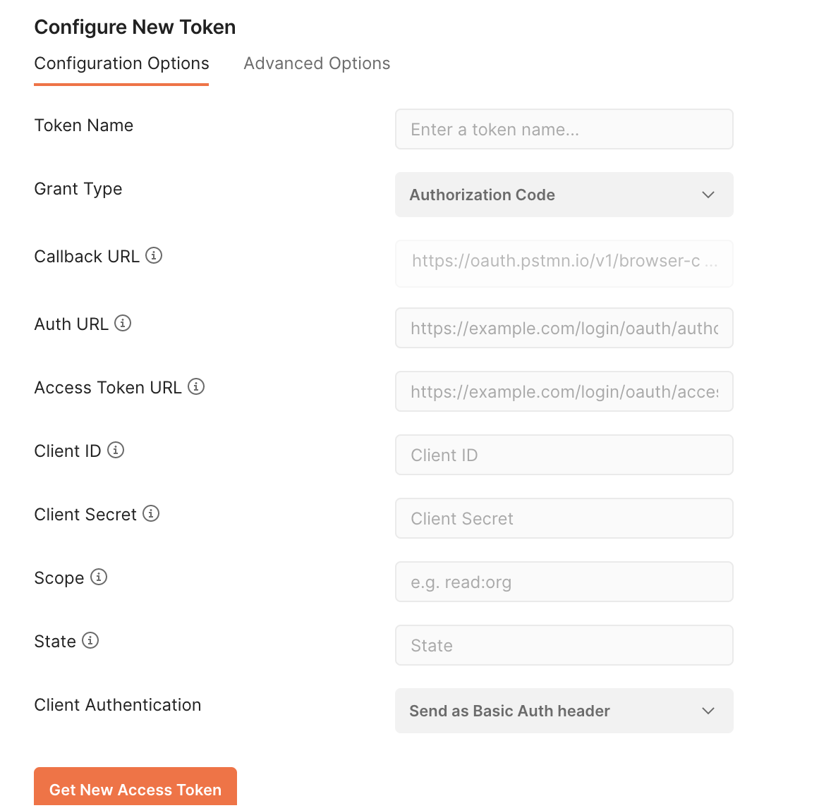
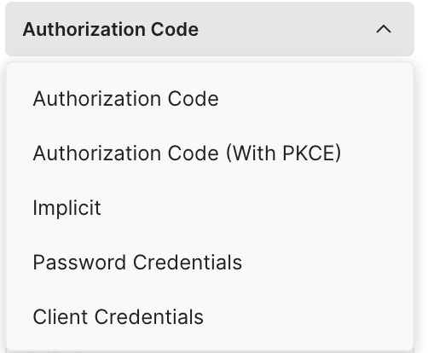
Do the OAuth Dance (in Postman)
Postman simplifies this process
Enter grant type and credentials
Get access token
Notes:
The OAuth Dance is complicated! Postman significantly simplifies this process by providing an organized user interface and system that does the dance for you with whichever grant type you choose, letting you easily gain your access token.

Slide 17
What does this have to do with workflows?
Almost every API you come in contact with will have some form of authentication and/or authorization.
This information is imperative to creating today’s workflow (and any other workflows or applications you create!)

Slide 18
Building our Workflow
The Spotify Recommendation Flow

Slide 19


What we’re gonna do
Spotify Song Recommendation Workflow
You've been hired by a busy music blogger to create a workflow that helps them discover new music. You'll use the Spotify Web API to let the blogger search for songs they like and find similar music!
In this exercise we will be using:
The Spotify API
OAuth 2
Postman

Slide 20
Workflow
Get access token (OAuth)
Get track id
Get track recommendations

Slide 21

Your turn!
The blogger wants more accurate song recommendations based on artists they like!
Build a workflow that allows the blogger to enter three artists to generate 5 song recommendations
Getting started
Fork this collection
Follow the instructions in “your turn!”

Slide 22

Going further
Explore the Spotify API reference
What workflows could you make?
Create a playlist of an authenticated user’s most-played songs
Create a playlist of songs with no words (for studying!)
Finds recommendations based on a user’s currently playing track
...Your idea here!

Slide 23

Continue Learning APIs as a Student Expert
Student Expert certification indicates that you are proficient in the essential skills involved in building and testing API requests in Postman, including:
Sending more sophisticated requests in Postman.
Editing documentation for a collection.
Writing basic test scripts.
Running collections, passing data between requests, and scripting request execution order.
Have the option to become a Student Leader in your community

Slide 24

Postman Student Expert
Apply here: https://bit.ly/postman-student-program
Notes:
Opportunity for students to get certified.

Slide 25

Q&A
Notes:
Open for Q&A, and attendees can continue getting support completing their collections

